Slide 1

Understanding Deep learning
Rajesh Talluri, PhD

Slide 2
Understand by asking questions
Ask the most basic question
Example: What is Deep Learning?
Gain enough understanding to be able to explain to others.
Why? And How? will follow through from What?

Slide 3
What is Deep learning?
Artificial intelligence

Slide 4
What is Deep learning?
Artificial intelligence
Models with the ability to understand, reason and adapt

Slide 5
What is Deep learning?
Artificial intelligence
Models with the ability to understand, reason and adapt
Machine learning

Slide 6
What is Deep learning?
Artificial intelligence
Models with the ability to understand, reason and adapt
Models with the ability to learn automatically from data
Machine learning

Slide 7
What is Deep learning?
Artificial intelligence
Models with the ability to understand, reason and adapt
Models with the ability to learn automatically from data
Machine learning
Deep learning

Slide 8
What is Deep learning?
Artificial intelligence
Models with the ability to understand, reason and adapt
Models with the ability to learn automatically from data
Machine learning
Deep learning
A subclass of machine learning algorithms which use multiple layers of artificial neural networks to learn from vast amounts of data

Slide 9
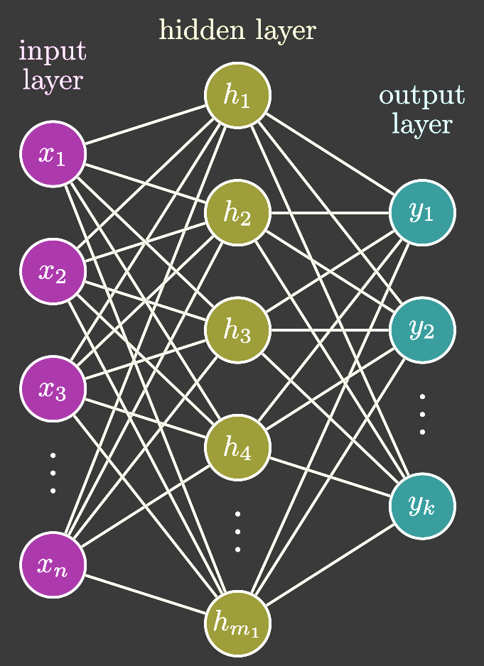
What are Artificial Neural Networks
Simple Neural Network

Slide 10
What are Artificial Neural Networks
Simple Neural Network
Networks of connected artificial neurons
Input layer neurons
Hidden layer neurons
Output layer neurons

Slide 11
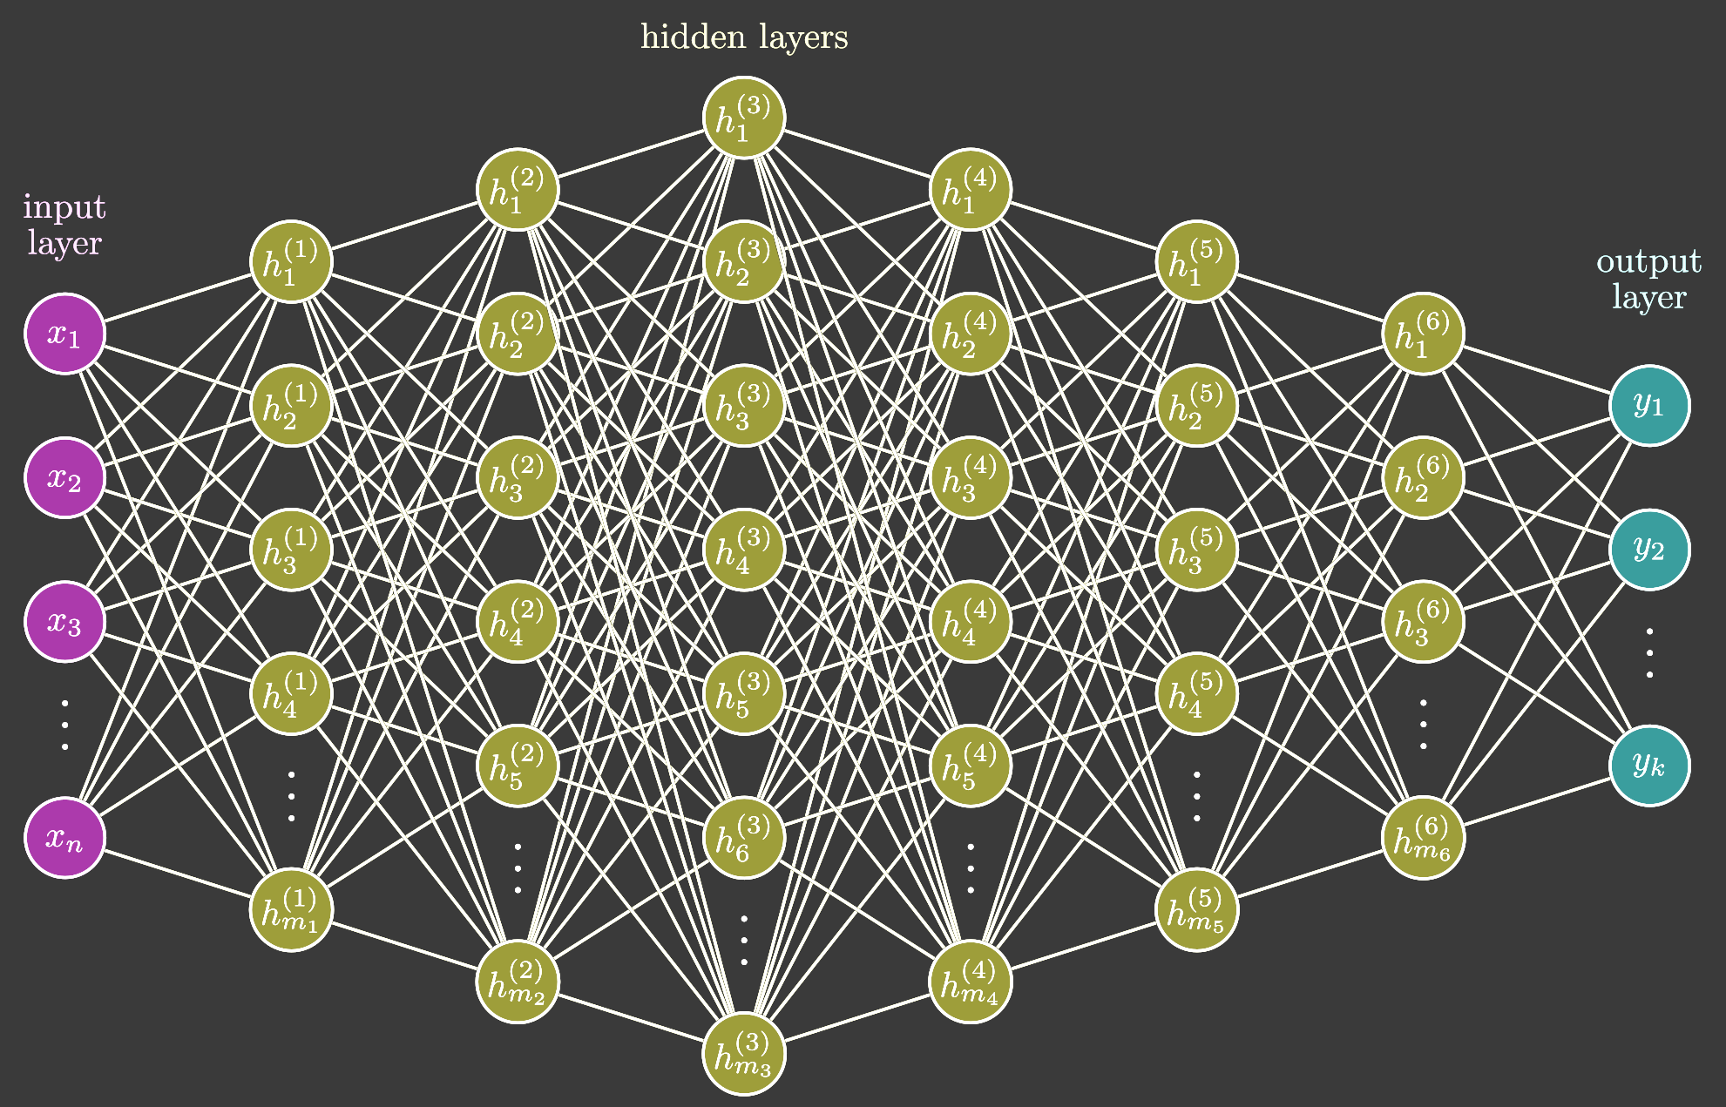
What are Artificial Neural Networks
Simple Neural Network
Deep Neural Network

Slide 12
What are Artificial Neural Networks
Simple Neural Network
Using Deep Neural Networks $≡$ Deep learning

Slide 13
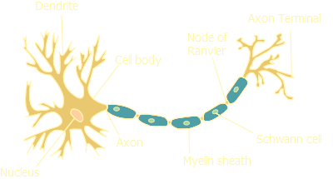
What is an Artificial Neuron?
What is a neuron?

Slide 14
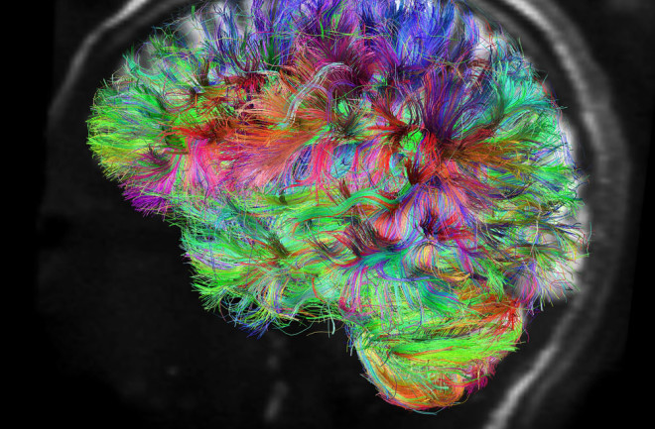
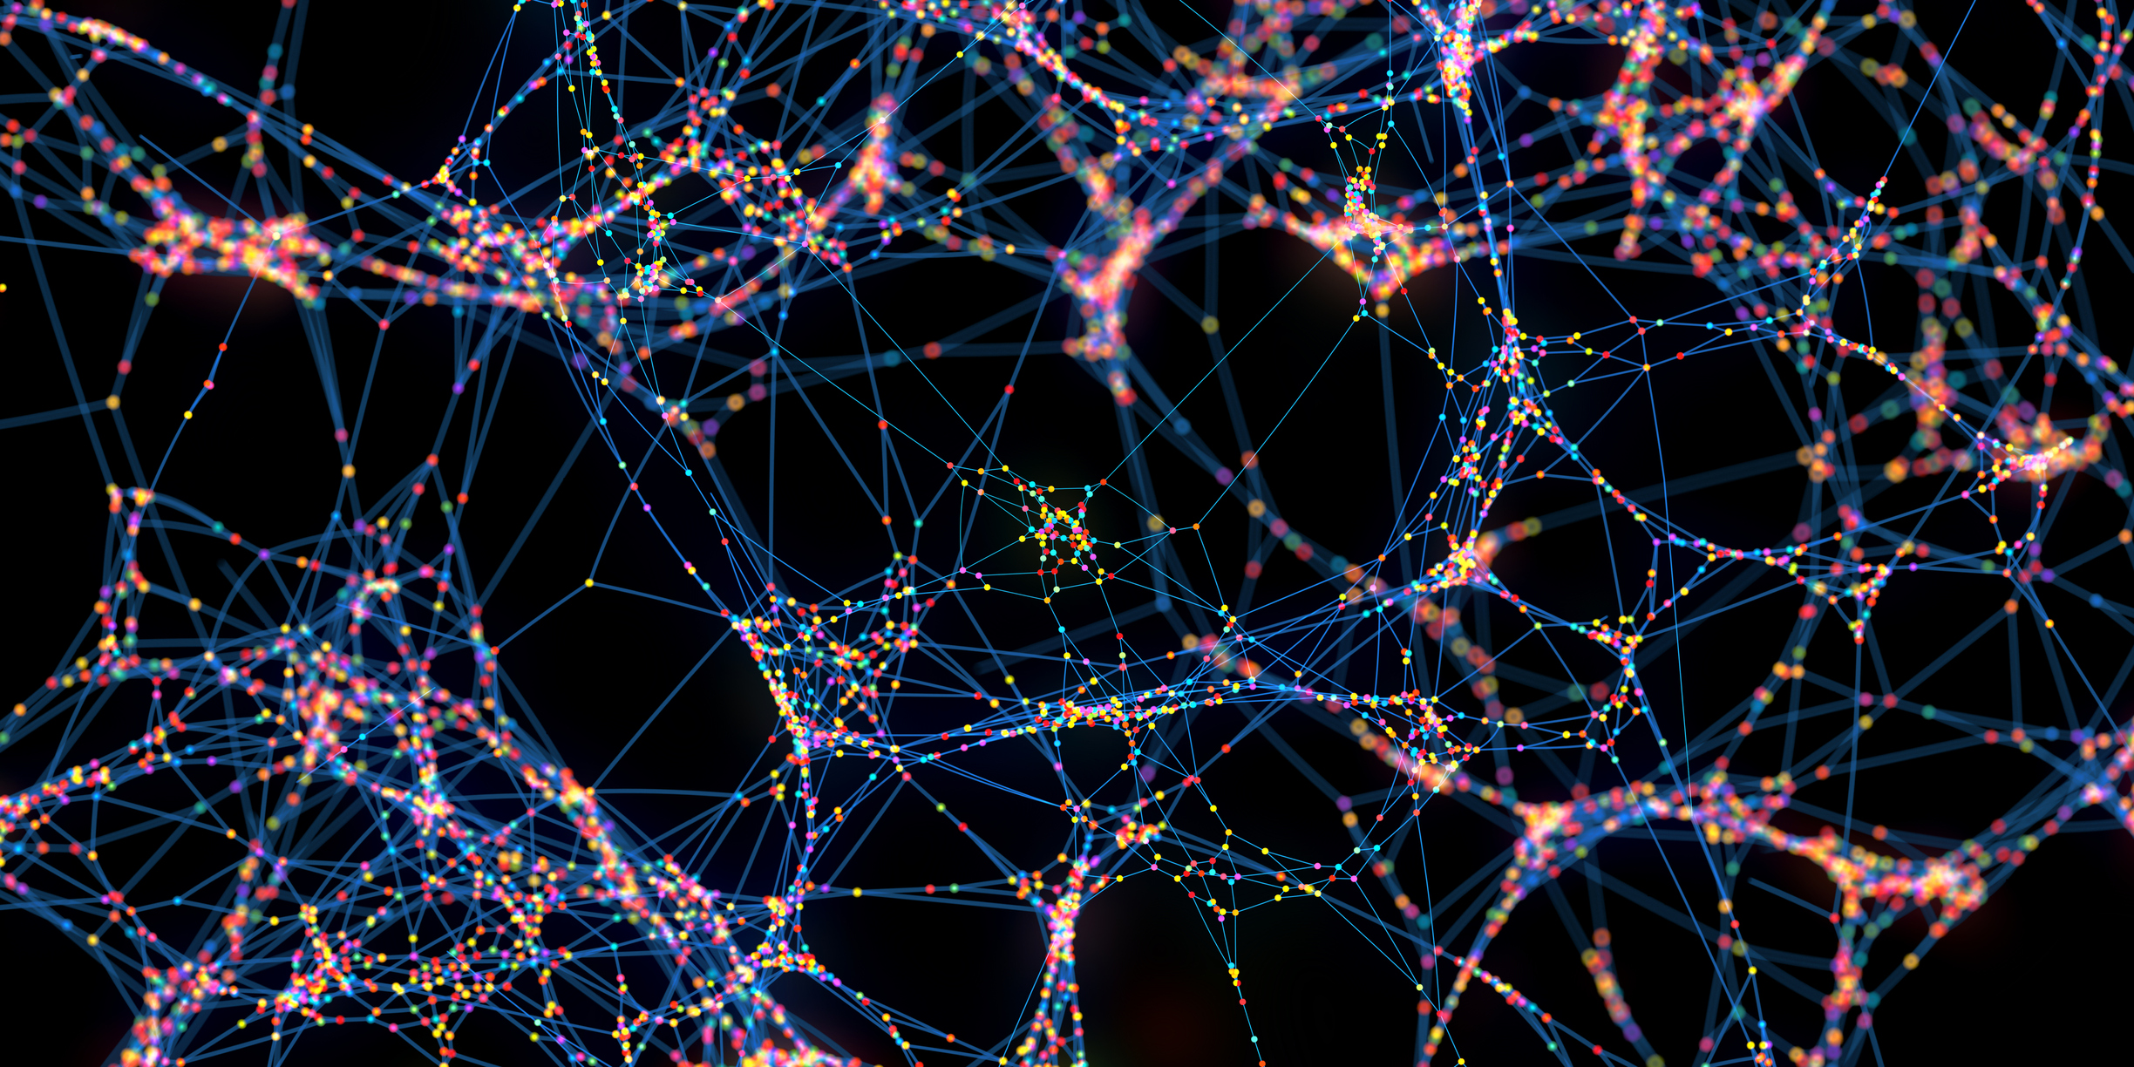
What is a neuron?
Average human brain consists of about 86 billion neurons
Each neuron is connected to up to 10,000 other neurons.
There are possibly 100-1000 trillion synaptic connections through which the neurons signal.

Slide 15
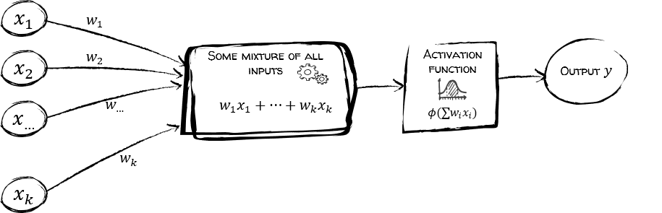
What is an Artificial Neuron?
Inspired by the biological neuron.

Slide 16
What is an Artificial Neuron?

Slide 17
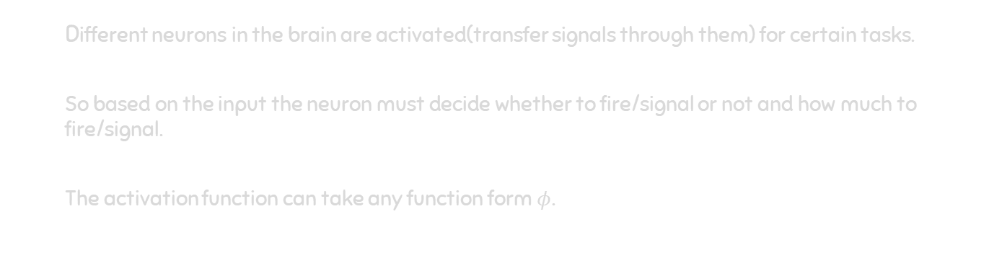
What is an Activation Function?
Different neurons in the brain are activated(transfer signals through them) for certain tasks.
So based on the input the neuron must decide whether to fire/signal or not and how much to fire/signal.
The activation function can take any function form $φ$.

Slide 18
Next Questions?
Next ???
How does a neuron function?
What is the purpose of a neuron?
What can a neuron do?
What have you learned till now?
What is deep learning?
What are artificial neural networks?
What is an artificial neuron?
What is an activation function?

Slide 19

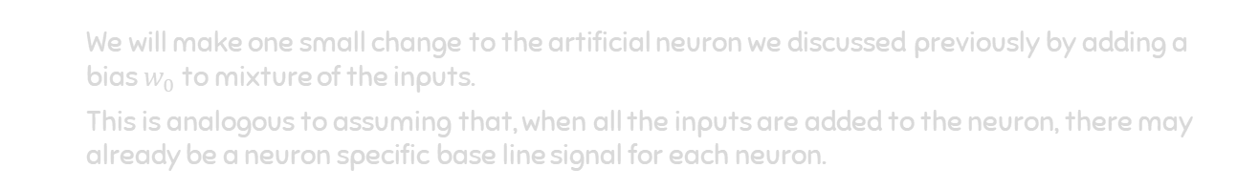
The Artificial Neuron
We will make one small change to the artificial neuron we discussed previously by adding a bias $w_{0}$ to mixture of the inputs.
This is analogous to assuming that, when all the inputs are added to the neuron, there may already be a neuron specific base line signal for each neuron.

Slide 20
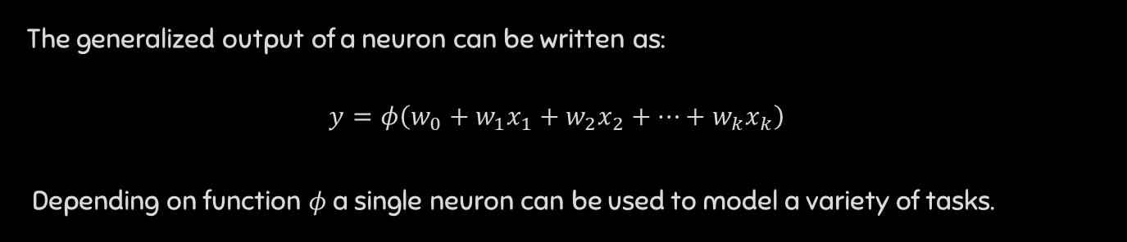
What can a single neuron do?
The generalized output of a neuron can be written as:
$$y=φ\left(w_{0}+w_{1}x_{1}+w_{2}x_{2}+…+w_{k}x_{k}\right)$$
Depending on function $φ$ a single neuron can be used to model a variety of tasks.

Slide 21
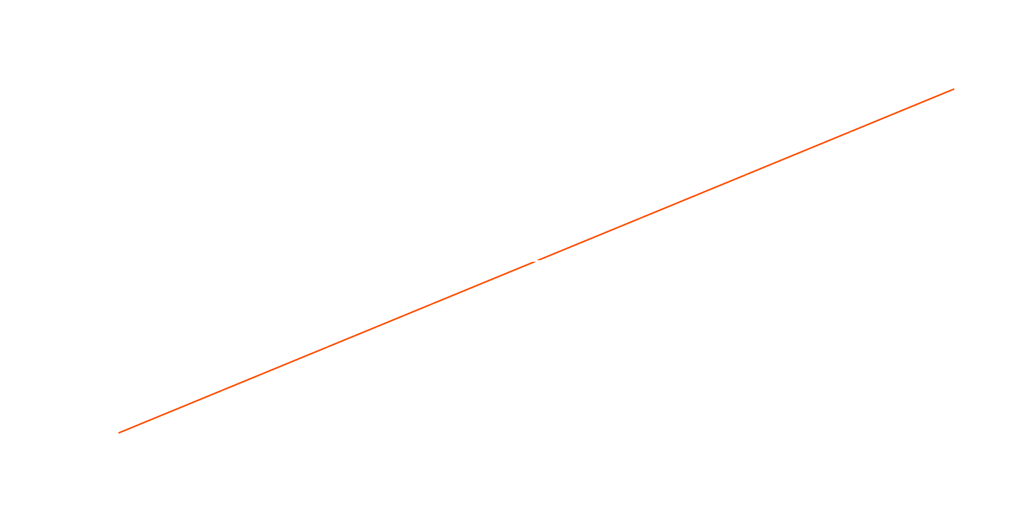
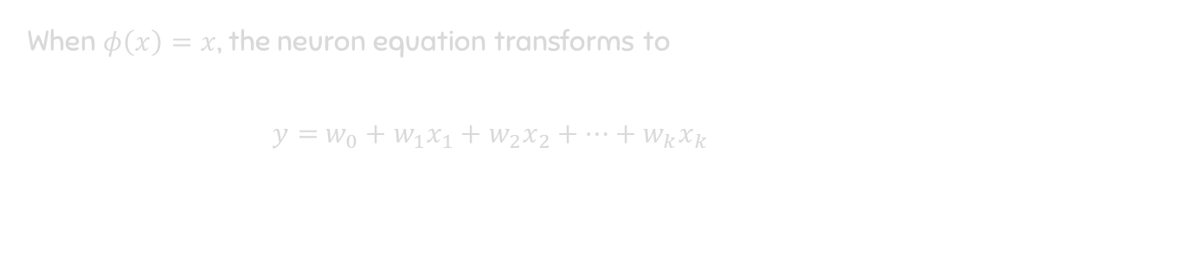
Linear Regression
When $φ\left(x\right)=x$, the neuron equation transforms to
$y=$ $w_{0}+w_{1}x_{1}+w_{2}x_{2}+…+w_{k}x_{k}$

Slide 22
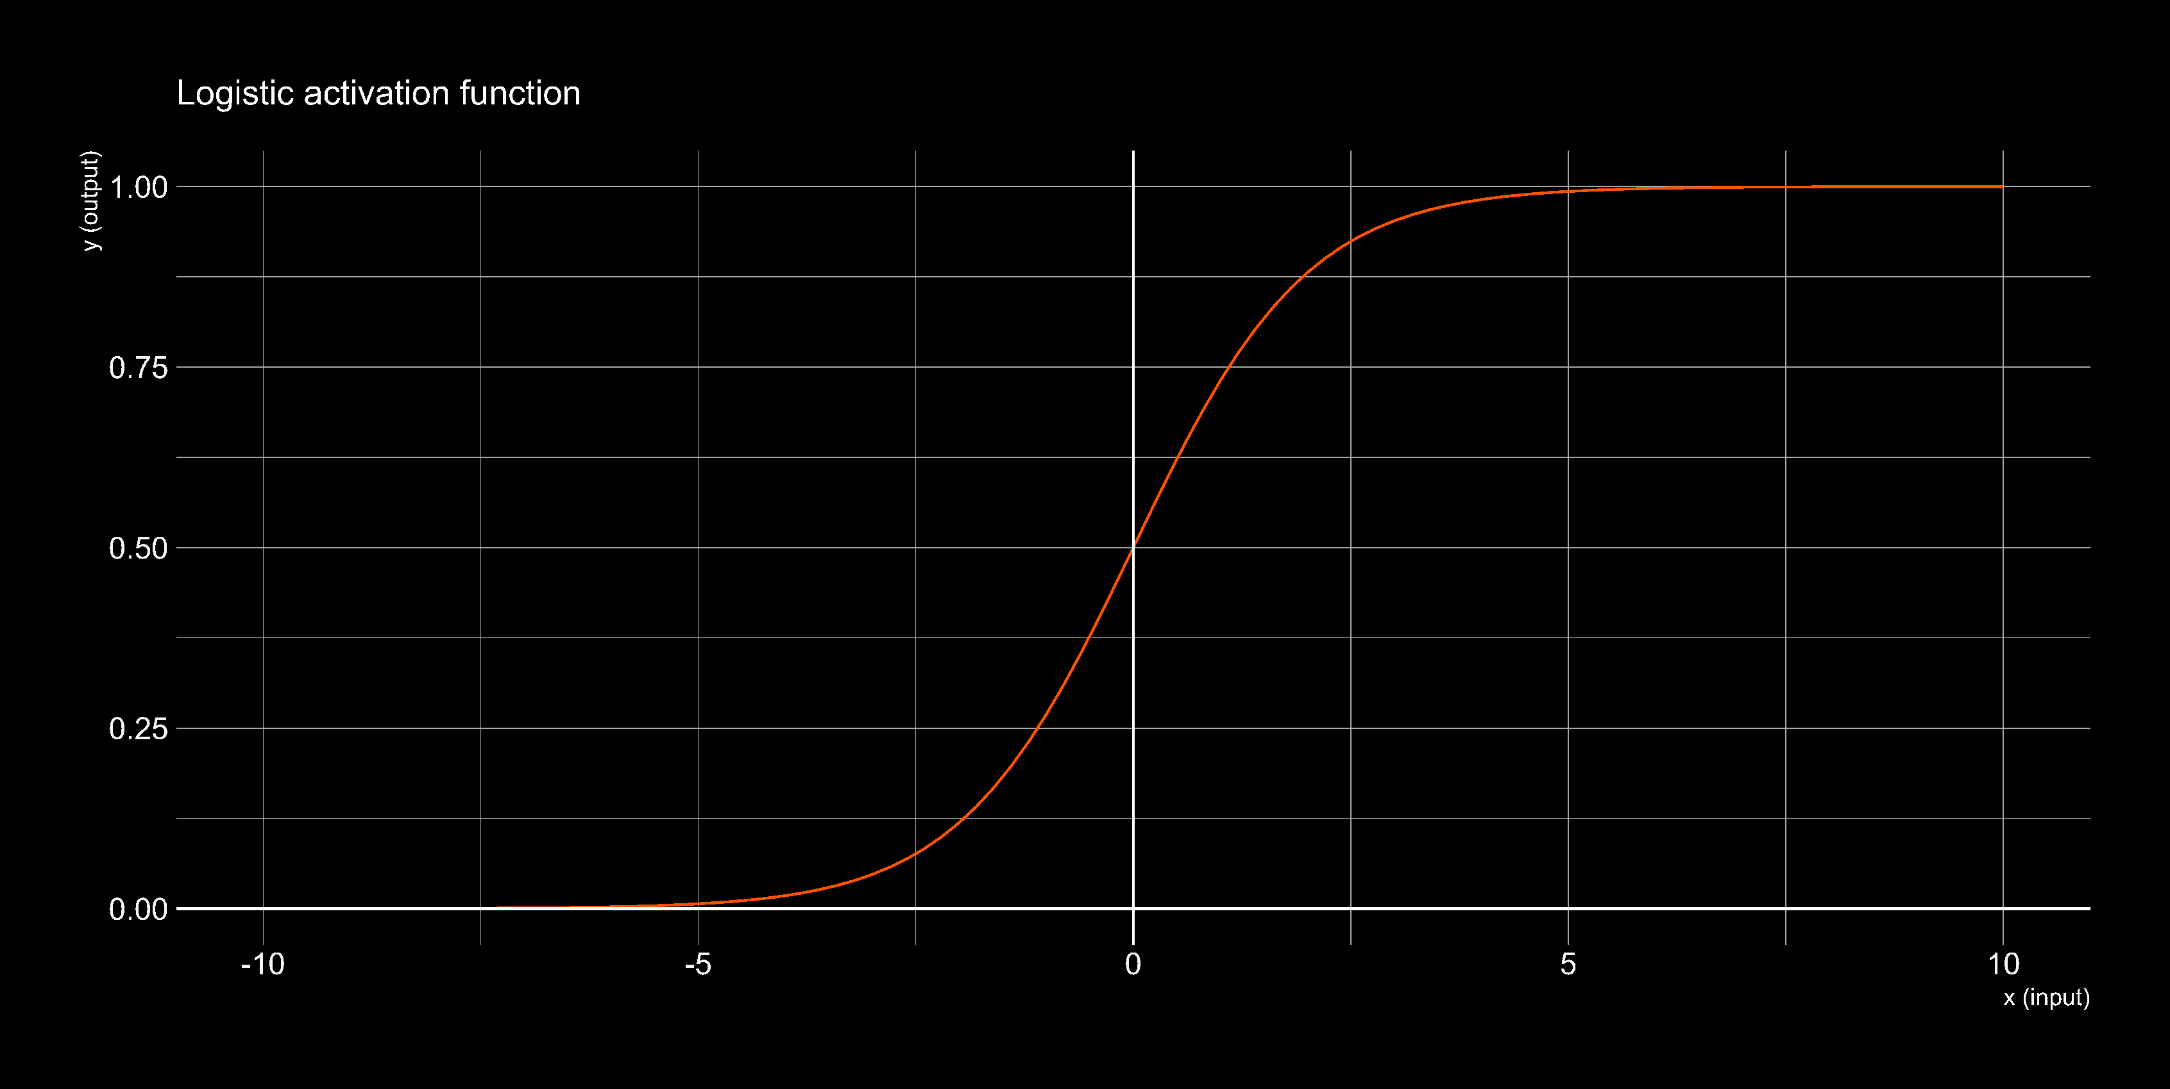
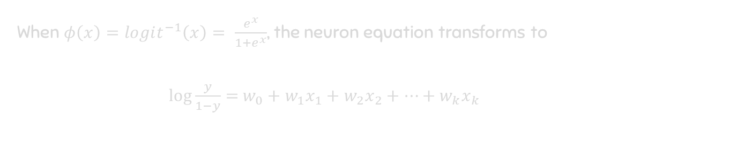
Logistic Regression
When $φ\left(x\right)=logit^{−1}\left(x\right)= \frac{e^{x}}{1+e^{x}}$, the neuron equation transforms to
$log\frac{y}{1−y}=$ $w_{0}+w_{1}x_{1}+w_{2}x_{2}+…+w_{k}x_{k}$

Slide 23

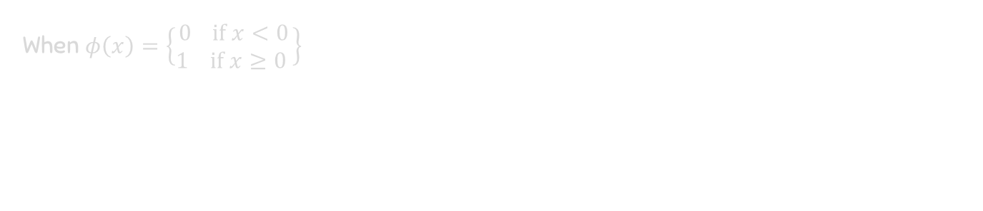
Linear Classification
When $φ\left(x\right)=\left\{\begin{matrix}0 \text{i}\text{f} x<0 \\ 1 \text{if} x≥0 \end{matrix}\right\}$

Slide 24
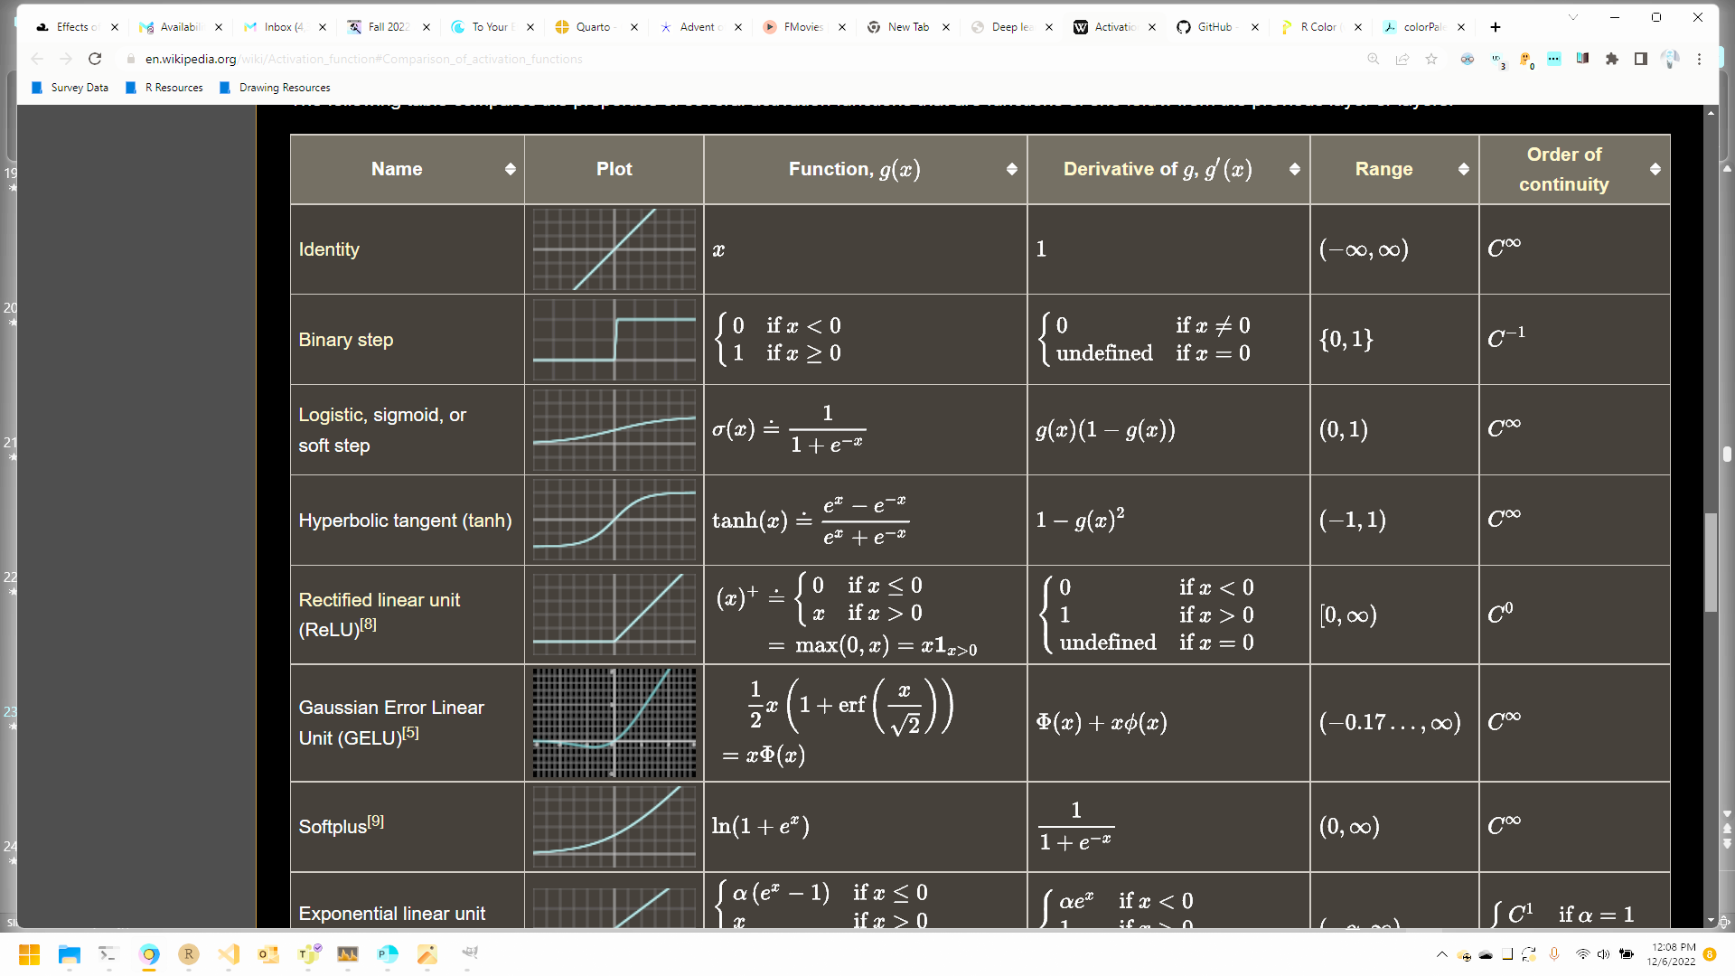
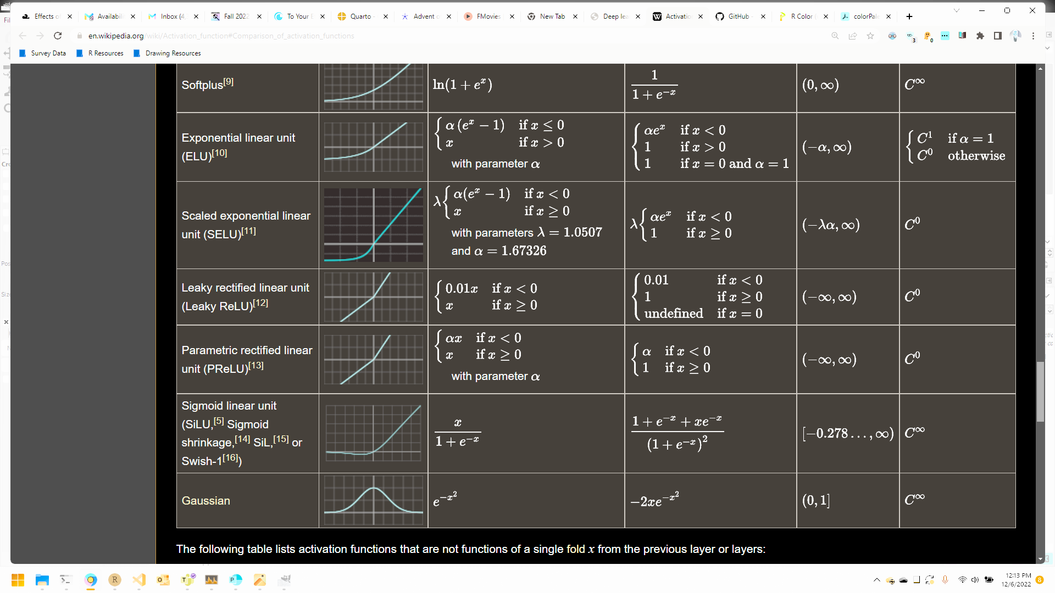
List of Activation functions

Slide 25

Biological Activation function
The rectified linear unit activation function (ReLU) is inspired by biology.

Slide 26
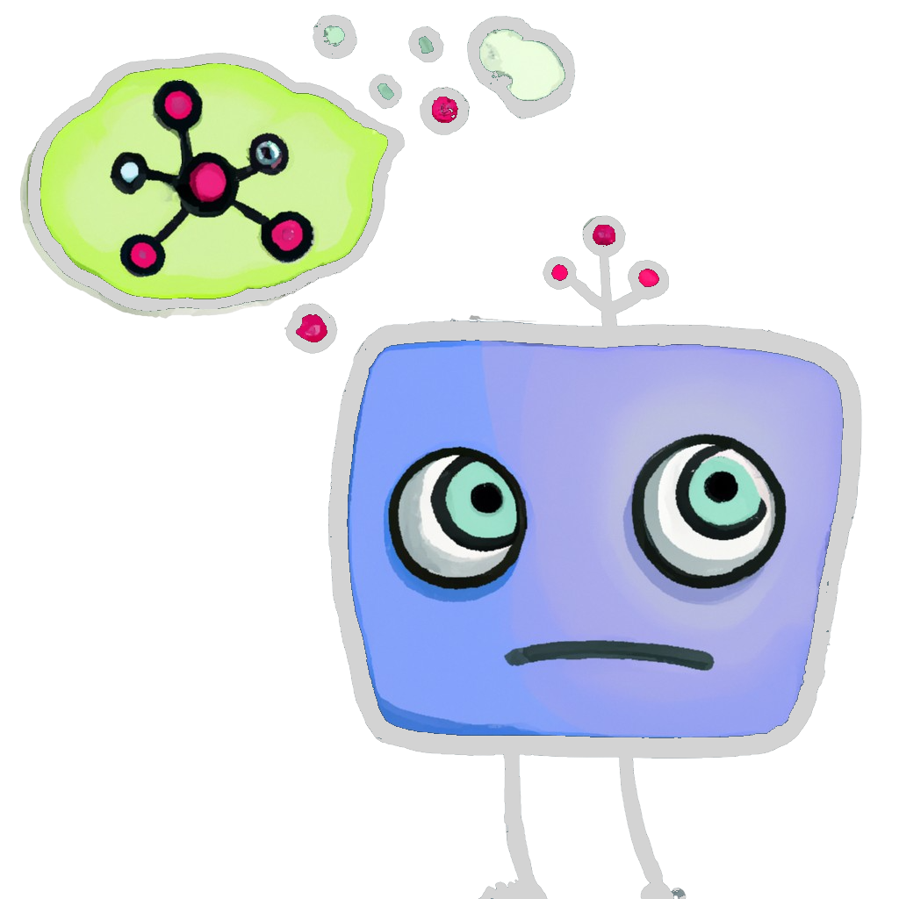




The Job of the Artificial Neuron?
I have data inputs $x_{1},x_{2},…, x_{k}$ from an individual
I know the activation function $φ$
I need to predict the output $y$ using the equation:
$$y_{pred}=φ\left(w_{0}+w_{1}x_{1}+w_{2}x_{2}+…+w_{k}x_{k}\right)$$
I need to get values for $w_{0},w_{1}, …, w_{k}$

Slide 27

The Job of the Artificial Neuron?
I need to get values for $w_{0},w_{1}, …, w_{k}$
How?
I could use previously collected data to “learn” these values…
How would I learn from previous data?

Slide 28


The “Learning” in Deep Learning?
How would I learn from previous data?
Previously collected data:
We have data inputs $x_{1},x_{2},…, x_{k}$ collected from $n$ individuals.
We have corresponding outputs $y$ for these $n$ individuals.
Need to learn weights $w_{0},w_{1},…, w_{k}$ from this data. How?
We only have the neuronal equation available to do this:
$$y_{pred}=φ\left(w_{0}+w_{1}x_{1}+w_{2}x_{2}+…+w_{k}x_{k}\right)$$

Slide 29

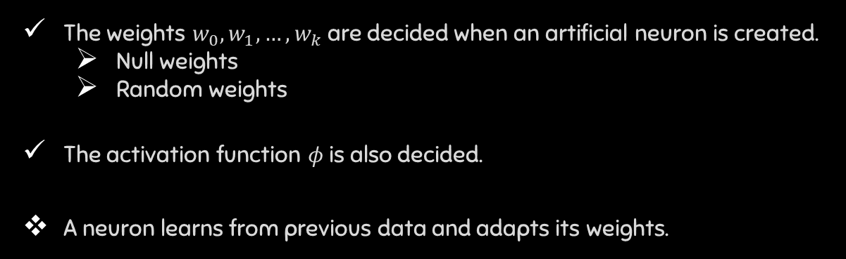
The Starting state of a Neuron?
The weights $w_{0},w_{1},…,w_{k}$ are decided when an artificial neuron is created.
Null weights
Random weights
The activation function $φ$ is also decided.
A neuron learns from previous data and adapts its weights.

Slide 30
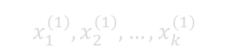
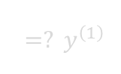
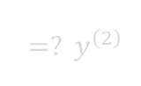
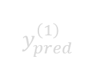
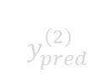


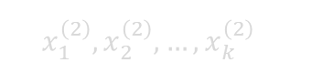
How does a neuron learn?
$$w_{0},w_{1},…,w_{k}$$
First data point
$y_{pred}^{\left(1\right)}$
$=? y^{\left(1\right)}$
$$x_{1}^{\left(1\right)},x_{2}^{\left(1\right)},…,x_{k}^{\left(1\right)}$$
Need to change w’s
$$w_{0},w_{1},…,w_{k}$$
Second data point
$y_{pred}^{\left(2\right)}$
$=? y^{\left(2\right)}$
$$x_{1}^{\left(2\right)},x_{2}^{\left(2\right)},…,x_{k}^{\left(2\right)}$$

Slide 31

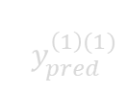
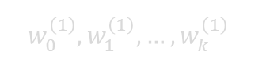
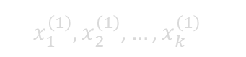

How does a neuron learn?
$$w_{0},w_{1},…,w_{k}$$
First data point
$y_{pred}^{\left(1\right)}$
$=? y^{\left(1\right)}$
$$x_{1}^{\left(1\right)},x_{2}^{\left(1\right)},…,x_{k}^{\left(1\right)}$$
Pick weights that minimize the distance between $y_{pred}$ and $y$
New weights
$$w_{0}^{\left(1\right)},w_{1}^{\left(1\right)},…,w_{k}^{\left(1\right)}$$
$y_{pred}^{\left(1\right)(1)}$
$=? y^{\left(1\right)}$
$$x_{1}^{\left(1\right)},x_{2}^{\left(1\right)},…,x_{k}^{\left(1\right)}$$

Slide 32
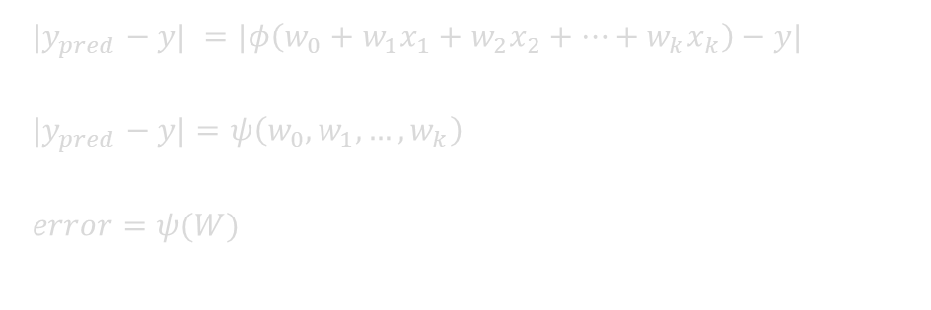
How does a Neuron learn?
Need to pick weights $w_{0},w_{1},…, w_{k}$ to minimize |$y_{pred}−y$|
$$|y_{pred}−y| =|φ\left(w_{0}+w_{1}x_{1}+w_{2}x_{2}+…+w_{k}x_{k}\right)−y|$$
$$|y_{pred}−y|=ψ\left(w_{0},w_{1},…,w_{k}\right)$$
$$error=ψ(W)$$

Slide 33



How to find $W$ that minimizes this function?
$$error=ψ(W)$$
$$ψ(W)$$
Minimum Error
$$W$$
W for Minimum Error
Ideas to find the $W$ for minimum error given $ψ(W)$?

Slide 34


Gradient descent
$$ψ(W)$$
$$W$$
The slope of a function give some idea if we are near a minimum.
The slope is zero near a minimum.

Slide 35

Gradient descent
$$ψ(W)$$
$$W$$
Find the new $W$.

Slide 36

Gradient descent
$$ψ(W)$$
$$W$$
Find the new gradient at the new $W$

Slide 37
Gradient descent
$$ψ(W)$$
$$W$$
Repeat the same procedure.

Slide 38
Gradient descent
$$ψ(W)$$
$$W$$

Slide 39
Gradient descent
$$ψ(W)$$
$$W$$

Slide 40
Gradient descent
$$ψ(W)$$
$$W$$

Slide 41
Gradient descent
$$ψ(W)$$
$$W$$

Slide 42

Gradient descent
$$ψ(W)$$
$$W$$
Slope is zero here, so we do not move.
This is the $W$ for minimum error.

Slide 43
How to find $W$ that minimizes this function?
$$error=ψ(W)$$
$$ψ(W)$$
$$W$$
Gradient descent does not solve this problem…

Slide 44
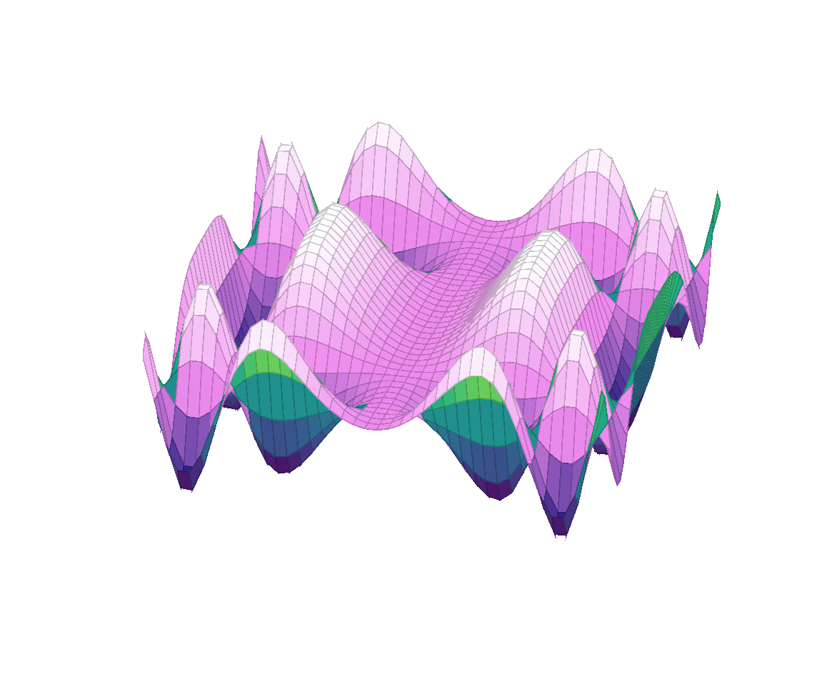


Loss function in two dimensions
$$W_{2}$$
$$ψ(W)$$
$$W_{1}$$

Slide 45
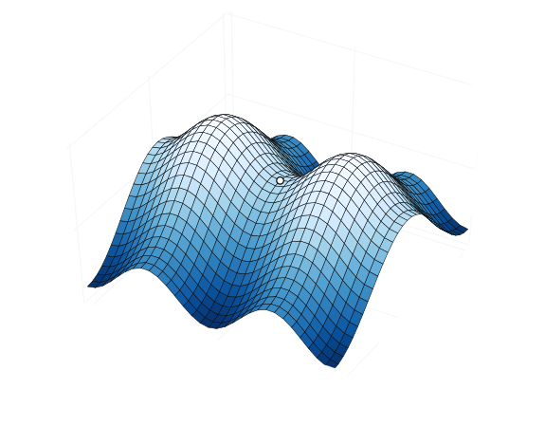
Saddle Points
$$ψ(W)$$

Slide 46
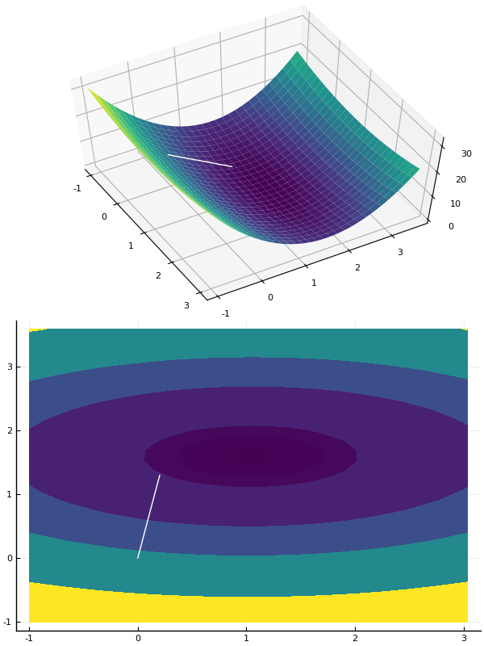
Learning rate
The amount of movement in the gradient direction is called the learning rate

Slide 47
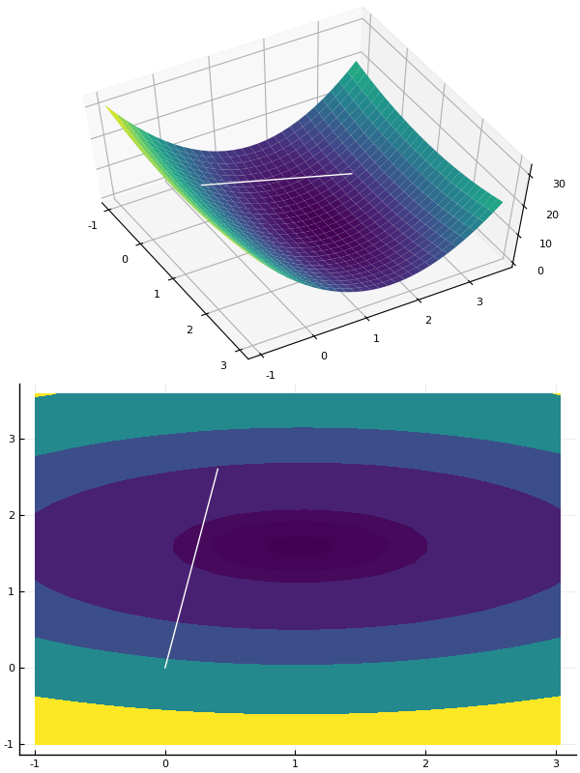
High Learning rate
Overshooting the target
making learning slow.

Slide 48
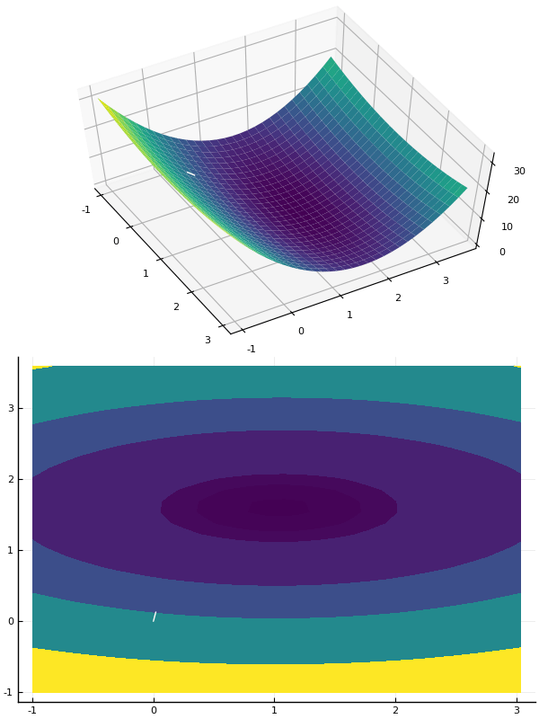
Low Learning rate
Not moving fast enough
making learning slow.

Slide 49

Unstable Learning rate
Moving too fast and diverging
making learning impossible.

Slide 50
Big Picture What did we learn?
Gradient Descent
Deep Neural Network

Slide 51
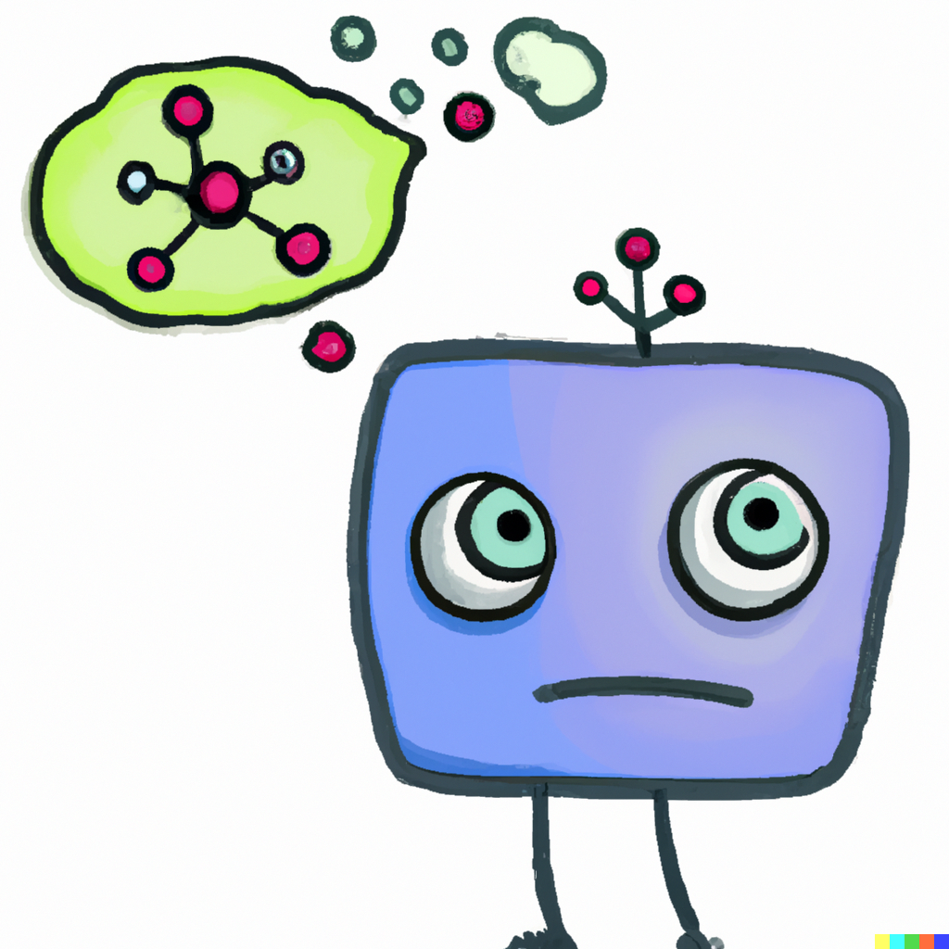
Text to Image Neural Networks
“A cute neuron thinking ??? in thinking cloud to the side of head”

